Slide 1

Manipulating Data with Talend

Slide 2





What will you learn today?
Understand how ETL is complementing Hadoop Ecosystem
Understand why Talend is used with Big Data
Learn Big Data not in months but in Minutes
Find out why Talend is important for Data Enthusiasts
Understand the Use Case – Banking Industry
Implement a Talend job with Hadoop

Slide 3
ETL with Big Data

Slide 4

ETL with Big Data
A Graphical Abstraction Layer on top of Hadoop Applications – this makes life so much easy in the Big Data buzz world
The typical assertion is that "Hadoop eliminates the need for ETL”…. Seriously ?
What no one seems to question in response to these sorts of comments is the naive assumptions these statements are based on !!
Is it realistic for most companies to move all of their data into Hadoop?

Slide 5



ETL with Big Data
Extra and Load
Machine
Data
ETL
Transactional
Data
Big Data
Workflow
Business Apps
Data

Slide 6
ETL with Big Data
Is writing ETL scripts in MapReduce code still ETL?
Is ETL running faster (in few cases & slower in others) on Hadoop eliminating ETL?
Is introduction of Hadoop changing when, where and how ETL happens?
Yes
No
Yes
The question isn't really that are we eliminating ETL, but where does ETL take place & how are we changing its definition

Slide 7
Why ETL?

Slide 8
Defining ETL
E
Represents the ability to consistently and reliably extract data with high performance and minimal impact to the source system
T
L
Stands for loading data into a persistent or virtual data store
Represents the ability to transform one or more data sets in batch or real-time into a consumable format

Slide 9
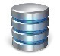


Why ETL + Hadoop?
How learning ETL (along Big Data) is addressing major business problems ?
BIG DATA
DATA INTEGRATION
DATA QUALITY
MDM
ESB
BPM
TALEND UNIFIED PLATFORM

Slide 10












One Stop Solution!!
An open source ecosystem
Improves efficiency of big data job design with graphic interface
Abstract and generates code
Run transforms inside Hadoop
Native support for HDFS, Sqoop, HBase, Mahout, Pig, Hive & MapReduce code generate
Apache License 2.0
Embedded in Hortonworks Data Platform
Certified with Cloudera, MapR and Grenplum

Slide 11
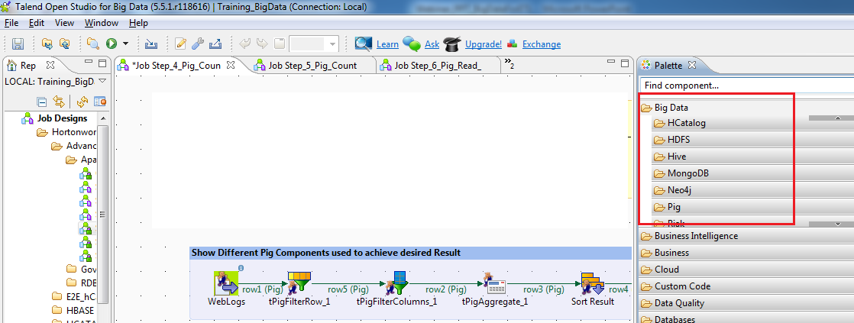
Talend
Q. Why Talend?
Ans . Because the more connected the world becomes, the more quickly a business must adapt

Slide 12
Why Talend?
Talend is the only Graphical User Interface tool which is capable enough to “translate” an ETL job to a MapReduce job. Thus, Talend ETL job gets executed as a MapReduce job on Hadoop and get the big data work done in minutes
This is a key innovation which helps to reduce entry barriers in Big Data technology and allows ETL job developers (beginners and advanced) to carry out Data Warehouse offloading to greater extent
With its Eclipse-based graphical workspace, Talend Open Studio for Big Data enables the developer and data scientist to leverage Hadoop loading and processing technologies like HDFS, HBase, Hive, and Pig without having to write Hadoop application code
Hadoop Applications, Seamlessly gets Integrated within minutes using Talend

Slide 13
Why Talend?
By simply selecting graphical components from a palette, arranging and configuring them, you can create Hadoop jobs
For example:
Load data into HDFS (Hadoop Distributed File System)
Use Hadoop Pig to transform data in HDFS
Load data into a Hadoop Hive based data warehouse
Perform ELT (extract, load, transform) aggregations in Hive
Leverage Sqoop to integrate relational databases and Hadoop

Slide 14
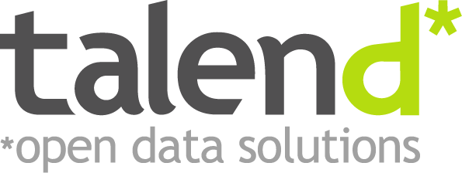
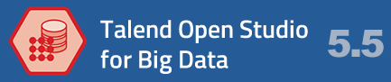
Talend Hadoop Integration

Slide 15
Talend Hadoop Integration
For Hadoop applications to be truly accessible to your organization, they need to be smoothly integrated into your overall data flows
Talend Open Studio for Big Data is the ideal tool for integrating Hadoop applications into your broader data architecture
Talend provides more built-in connector components than any other data integration solution available, with more than 800+ connectors that make it easy to read from or write to any major file format, database, or packaged enterprise application
For Example, in Talend Open Studio for Big Data, you can use drag 'n drop configurable components to create data integration flows that move data from delimited log files into Hadoop Hive, perform operations in Hive, and extract data from Hive into a MySQL database (or Oracle, Sybase, SQL Server, and so on)

Slide 16
Talend Hadoop Integration
More and more enterprise wanted to scale up in Hadoop/Big Data technologies with use of existing pool of talent and reduce overspending on map-reduce programmer (which is pretty new and expensive)
High rise of job trend in Data Scientist/Data Analysis (Talend also comes along with basic BI transformations which reduces your dependency on simple excel dash board/ BI tools)
Gartner is featuring Talend as the best technology in market for Data Integration and Big Data
3 major players in Big Data industry, Hortonworks, Cloudera, MapR have already tied up with Talend for big data solutions
And mostly any level person in industry can quickly get started on this without much pre-requisites
Myth : I don’t know Java programming , how would this course help me learn and excel in Big Data? The biggest advantage you get with Talend for Big Data is “there is no prerequisite” to learn this concept. Whether you come with prior knowledge of Hadoop or not , this course has some or other best things to offer

Slide 17

Big Data & Data Analysis in 10 minutes
Learn Big Data not in months but in Minutes!! Sounds too good ? But true
MAPR
HORTONWORKS
CLOUDERA
HADOOP
Go from zero to big data in under 10 minutes
Get big data without coding. The Talend Big Data Sandbox is a ready-to-run virtual environment that includes Talend Platform for Big Data, popular Hadoop distributions and data examples

Slide 18
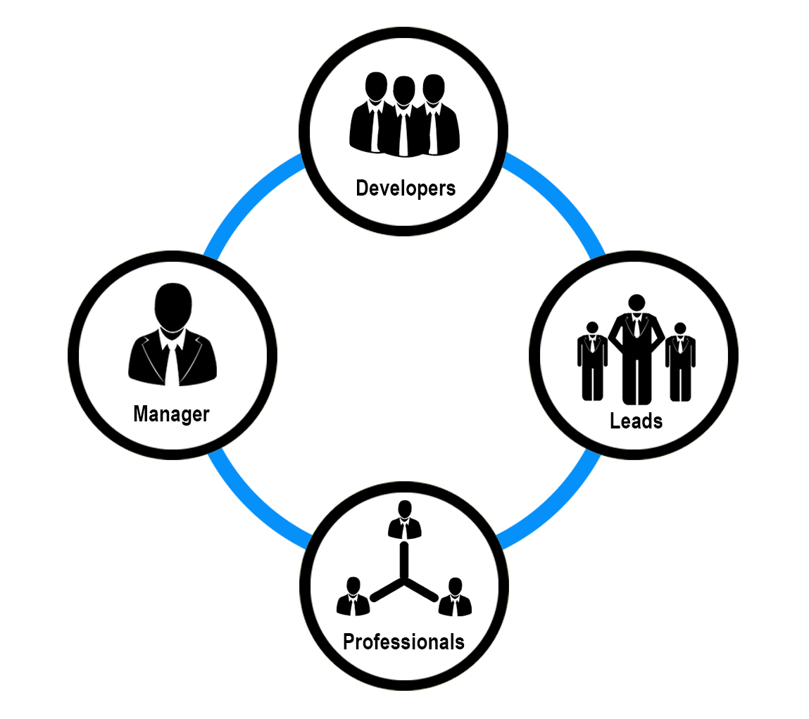
Who can use “Talend for Data Analysis”!!

Slide 19

We are just about to see the Bigger Picture
Let us all see quickly, what Talend can do in minutes, reducing the man-hours in doing MapReduce programming in Hadoop, shall we?

Slide 20
Demo

Slide 21
Real time Use Case:Talend(data analysis)+ BigData
In this section, you will be able to sense the true power of Talend+Big Data
A Banking industry use case :
“Addressing the challenges in growing the business with use of flexible data analysis hybrid Big Data tool“ .
We used a completely unstructured log data , which need to be structured then analysed and then business sense has to come from it and imagine if all of that has to happen on top of haddop ?
Lets see the magic.

Slide 22

Project
Use Case
It is not only a question of standard ETL tool and how best it can offer integration features.
The question is what else it has to offer for current pain areas in enterprise level so that without extra efforts like 1. resource investment 2,skills 3.training 4.license investment , we still can manage all of that in one tool.
Yes that’s possible to some extent. How ?

Slide 23
Environment Setup
Our use case setup is using the below :
Hortonworks Sandbox 1.3
Talend Open Studio for Big Data 5.5
Talend Open Studio for Data Integration 5.6
Windows 7 (64 Bit OS)
Machine : 4GB RAM , i3 processor

Slide 24
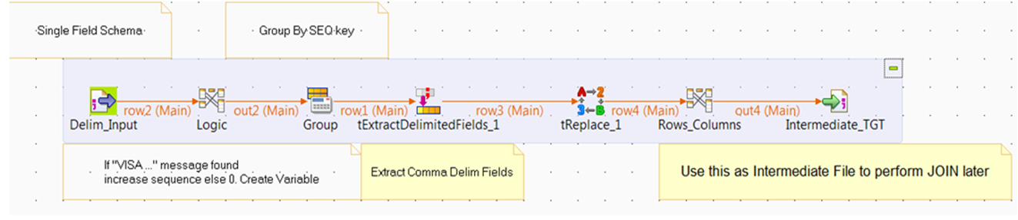
Use-case Snapshot

Slide 25
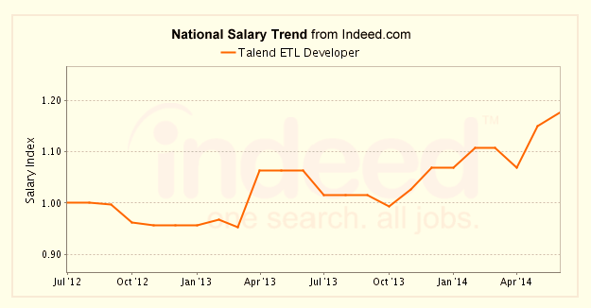
Salary Trend

Slide 26
References
https://www.talend.com/resource/hadoop-applications.html
http://www.edureka.co/blog/big-data-and-etl-are-family/

Slide 27
Thank You
Questions/Queries/Feedback
Recording and presentation will be made available to you within 24 hours

